Slide 1
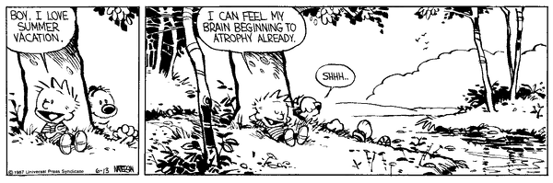
Mu 101: Introduction to Music
Reading/attendance quiz!
Instructor: Dr. Alice Jones
Queensborough Community College
Fall 2017
Sections J2 (Tuesdays 3:10-6) and C3A (Wednesdays 9:10-12)

Slide 2
Recap
A composer can’t control everything that happens in a performance
A big part of music in the 20th century is exploring the question “What is music?”
  Sound and noise vs. “music”
  Electronics
  Aesthetic trends: serialism (12-tone), minimalism, avant-garde, neo-classicism, neo-romanticism, multiculturalism

Slide 3
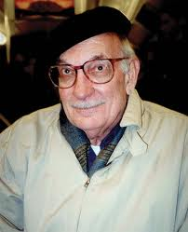
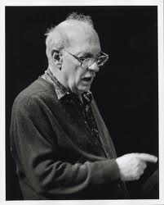
George Crumb (b. 1929)
West Virginia
Educated at Mason College of Music (BA 1950), University of Illinois at Urbana-Champaign (MM), University of Michigan (DMA 1959)
Music explores extended timbres and big philosophical questions: what is time, why are we here, what does it mean to be human (evolution, relationship to the natural world)
Experimental (sound production and theatricality) but conservative (often sonically pleasant)

Slide 4
George Crumb (b. 1929)
Eleven Echoes of Autumn (1965)
Echoes of Time and the River (Echoes II) (1967)
Ancient Voices of Children (1970)
Vox Balaenae (Voice of the Whale) (1971)
Music for a Summer Evening (Makrokosmos III) (1974)
Dream Sequence (Images II) (1976)
Star-Child (1977)
Celestial Mechanics (1979)
An Idyll for the Misbegotten (Images III) (1986)
A Haunted Landscape (1987)
Mundus Canis (A Dog’s World) (1998)
Eine Kleine Mitternachtmusik (A Little Midnight Music) (2001)
Otherworldly Resonances (2003)

Slide 5
George Crumb, Black Angels (1970)
Subtitle: Thirteen Images from the Dark Land: a parable on our troubled contemporary world
Finding overwhelming beauty all around:
  Insects
  Melodies that evoke different musics from around the world
  Percussive sounds
  Spiritual sounds of the universe, becoming aware of the big-ness of the world
Music is “a system of proportions in the service of a spiritual impulse”
“Debussy really was one of the first composers to make the sheer sound a very special aspect of the music… everything in sound is useable if its’ justified in the music itself… All of the sounds I’ve borrowed from eastern music, Asian music, and so forth, are sounds that are in my ear.” (interview, 1988)

Slide 6
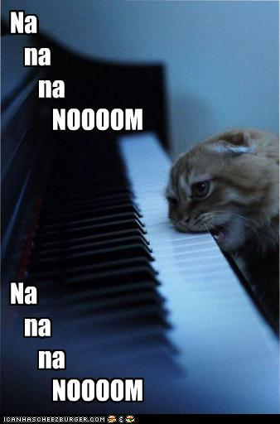
Final thoughts?
Not all music is worth listening to multiple times, but all music is worth listening to once
To commit to education is to commit to growing
“Just listen with the vastness of the world in mind.
You can’t fail to get the message.” —Pierre Boulez

Slide 7
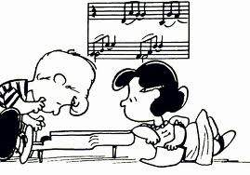
Reminders
Concert Response Essay – due at the final exam, December 19/20 (hard copy)
Optional extra credit – due the day of your final exam (via email by 11:59 pm)
Final exam = Final discussion and writing project
  Topic available in a blog post starting December 12

Slide 8
End write
What’s the most interesting, valuable, or helpful thing you’ve learned in Mu 101 this semester?

